Slide 1
MICROSOFT COMPANY
Overview
Microsoft Company has decided to create a new movie studio and requires more insights into which types of films are doing best at the box office. This project uses descriptive statistical analysis on data gathered from IMDb website to gain insight on which movies are the most popular.
Two separate datasets were used for this analysis to gain insights into the top 5 most and least rated movies, Also looked into movies that brought more domestic gross sales.

Slide 2
Business Understanding
Microsoft wants to produce movies that are going to be successful in the market in order to make profits, they want to know which types of movies are the most successful.
To answer that question Domestic gross data was analyzed to check the most income generating successful movies, along with frequency given and number of votes for each type.
To check popularity with the financial gains it brings to the table success.

Slide 3
Data Analysis
After the data analysis here are the top 5 most popular movies staring with the most popular:
Eden
Truth or Dare
Legend
Paranoia
The Void

Slide 4
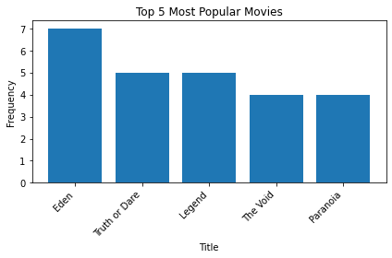

Slide 5
Data Analysis
Also find the top 5 least popular movies highlighted below;
Snow Piercer
Life in a day
Phantom Boy
Spirits-Home coming
Pride and Prejudice and Zombies

Slide 6
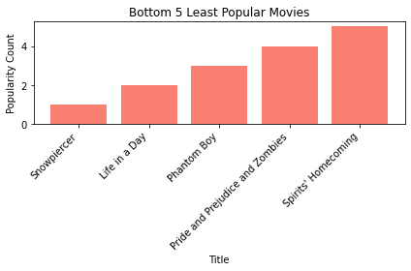

Slide 7
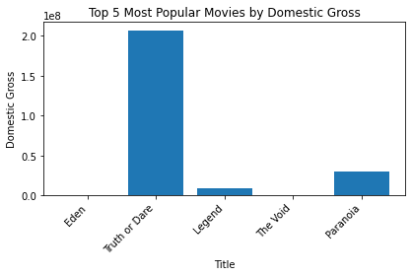
Data Analysis
Did an analysis of the domestic earnings from the top 5 most popular movies
This Is necessary so that we check which movie is more profitable

Slide 8
Conclusion
From the data collected and analyzed, we can conclude that.
Most people prefer to watch Eden, Truth and Dare, Legend, The Void and Paranoia
As much as Eden is the most popular movie, it's income gross is less.
Truth and Dare is second most popular movie and fetches more Domestic Gross than the rest of the top 5
Recommendation
From the data collected and analyzed; I recommend Microsoft to;
Produce Eden, Truth and Dare, Legend, The Void and Paranoia Movies.
Truth and Dare movie should be given top priority it earns more Domestic Gross than the rest.
Next Steps
We should consider the age range from which this statistics were collected.
Also we can check the preferred day and time of the week that people like to watch movies

Slide 9
Thank You
Phoebe.wawire@student.moringaschool.com
Linkedln; CCOP Phoebe Wawire

